Slide 1


Ferroglobe’s Operations and FerroQuartz Mauritania
Jean du Plessis
Vice President Mining

Slide 2
Forward-Looking Statement
This presentation contains forward-looking statements within the meaning of Section 27A of the United States Securities Act of 1933, as amended, and Section 21E of the United States Securities Exchange Act of 1934, as amended. Forward-looking statements are not historical facts but are based on certain assumptions of management and describe our future plans, strategies and expectations. Forward-looking statements can generally be identified by the use of forward-looking terminology, including, but not limited to, "may," “could,” “seek,” “guidance,” “predict,” “potential,” “likely,” "believe," "will," "expect," "anticipate," "estimate," "plan," "intend," "forecast," or variations of these terms and similar expressions, or the negative of these terms or similar expressions.
Forward-looking statements contained in this presentation are based on information presently available to us and assumptions that we believe to be reasonable, but are inherently uncertain. As a result, our actual results, performance or achievements may differ materially from those expressed or implied by these forward-looking statements, which are not guarantees of future performance and involve known and unknown risks, uncertainties and other factors that are, in some cases, beyond our control.
You are cautioned that all such statements involve risks and uncertainties, including without limitation, risks that the businesses of Globe Specialty Metals Inc. and Grupo FerroAtlántica (together, “we,” “us,” “Ferroglobe,” the “Company”) will not be integrated successfully or that we will not realize estimated cost savings, value of certain tax assets, synergies and growth, or that such benefits may take longer to realize than expected. Important factors that may cause actual results to differ include, but are limited to: (i) risks relating to unanticipated costs of integration, including operating costs, customer loss and business disruption being greater than expected; (ii) our organizational and governance structure; (iii) the ability to hire and retain key personnel; (iv) regional, national or global political, economic, business, competitive, market and regulatory conditions including, among others, changes in metals prices; (v) increases in the cost of raw materials or energy; (vi) competition in the metals and foundry industries; (vii) environmental and regulatory risks; (viii) ability to identify liabilities associated with acquired properties prior to their acquisition; (ix) ability to manage price and operational risks including industrial accidents and natural disasters; (x) ability to manage foreign operations; (xi) changes in technology; (xii) ability to acquire or renew permits and approvals; (xiii) changes in legislation or governmental regulations affecting Ferroglobe; (xiv) conditions in the credit markets; (xv) risks associated with assumptions made in connection with critical accounting estimates and legal proceedings; (xvi) Ferroglobe's international operations, which are subject to the risks of currency fluctuations and foreign exchange controls; and (xvii) the potential of international unrest, economic downturn or effects of currencies, tax assessments, tax adjustments, anticipated tax rates, raw material costs or availability or other regulatory compliance costs. The foregoing list is not exhaustive.
You should carefully consider the foregoing factors and the other risks and uncertainties that affect our business, including those described in the “Risk Factors” section of our Registration Statement on Form F-1, Annual Reports on Form 20-F, Current Reports on Form 6-K and other documents we file from time to time with the United States Securities and Exchange Commission. We do not give any assurance (1) that we will achieve our expectations or (2) concerning any result or the timing thereof, in each case, with respect to any regulatory action, administrative proceedings, government investigations, litigation, warning letters, consent decree, cost reductions, business strategies, earnings or revenue trends or future financial results. Forward- looking financial information and other metrics presented herein represent our key goals and are not intended as guidance or projections for the periods presented herein or any future periods.
We do not undertake or assume any obligation to update publicly any of the forward- looking statements in this presentation to reflect actual results, new information or future events, changes in assumptions or changes in other factors affecting forward-looking statements. If we update one or more forward-looking statements, no inference should be drawn that we will make additional updates with respect to those or other forward-looking statements. We caution you not to place undue reliance on any forward-looking statements, which are made only as of the date of this presentation.

Slide 3

AGENDA
Introduction to Ferroglobe
Market Outlook
FerroQuartz Mauritania

Slide 4
Introduction to Ferroglobe

Slide 5
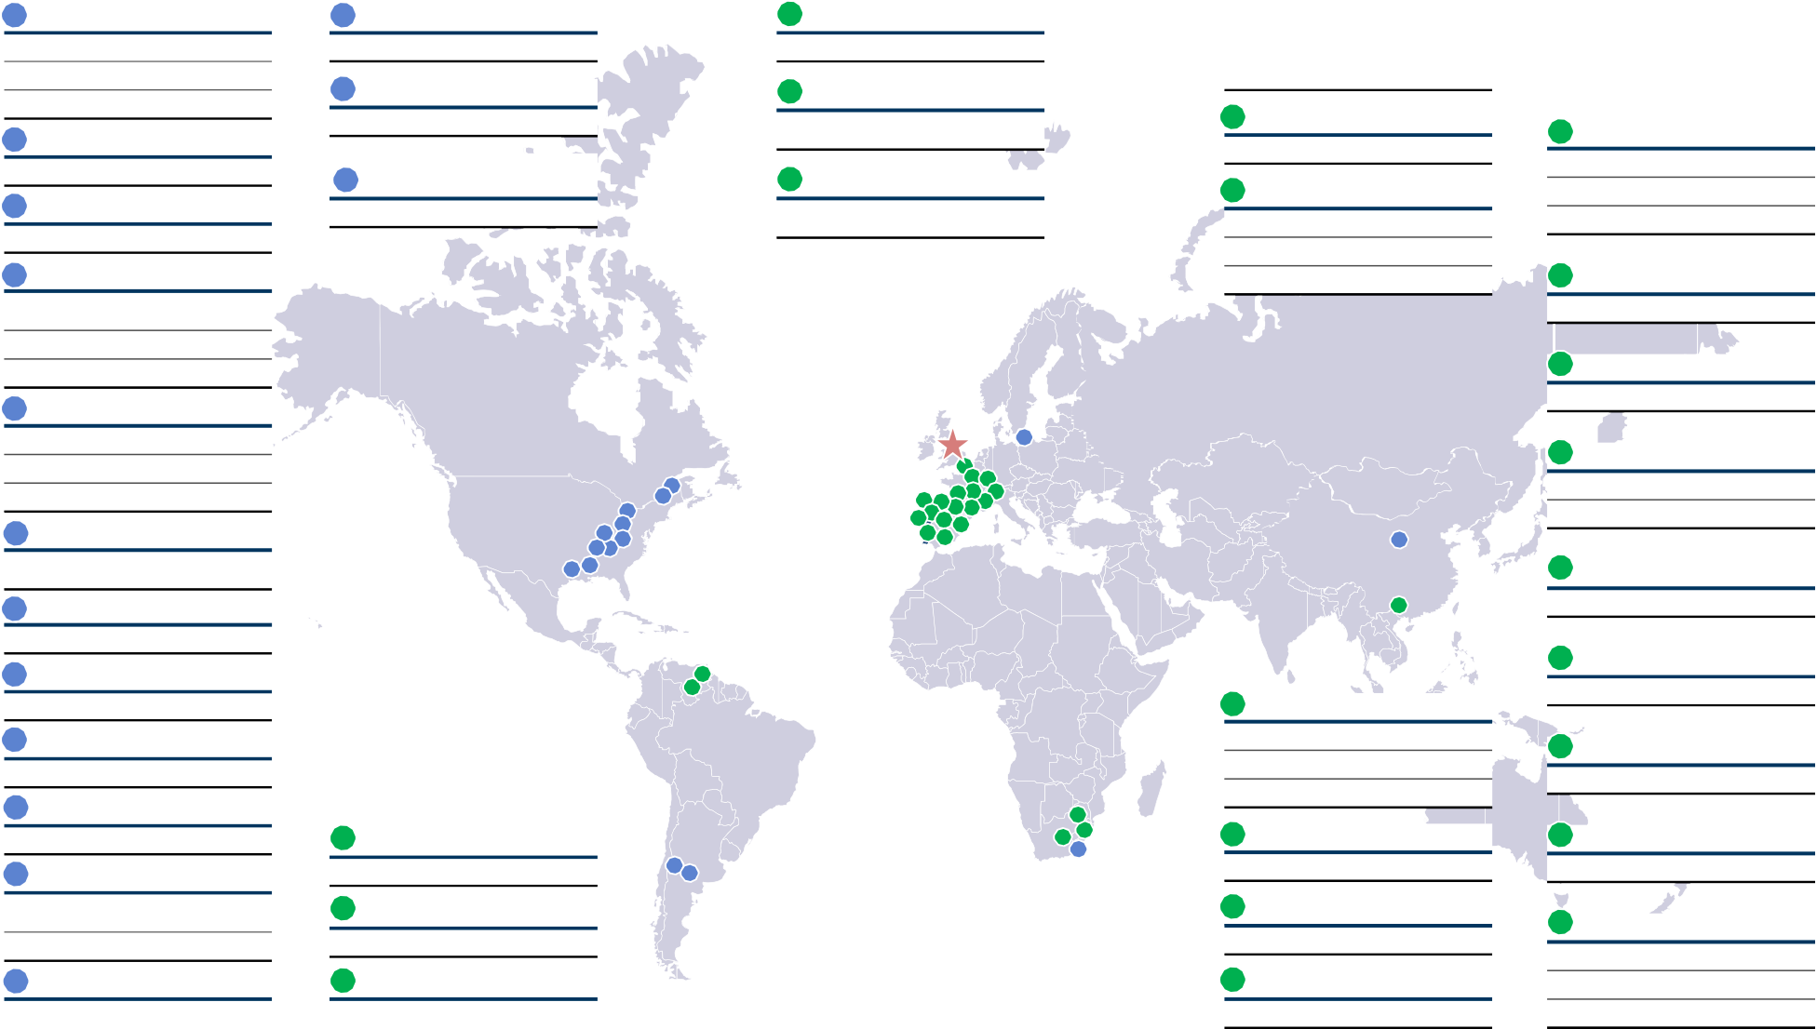

Strong business profile uniquely positioned to deliver value
World-class assets on five continents, no operating overlap
Industry-leading and improved cost position through diversified currency exposure
2
Bécancour, Canada
14
New Castle, South Africa
20
Serrabal, Spain
23
Laudun, France
30
Boo, Spain
Silicon JV | 45,000 mt | Ferrosilicon | 45,000 mt | Quartz Mine | Silicon | 23,000 mt |  | Ferro Manganese | 57,000 mt
Globe 51% | 23,000 mt |  |  |  | Ferrosilicon | 35,000 mt |  | Silicomanganese | 115,000 mt
Dow Corning 49%
22,000 mt
15
Police, Poland
21
Hydro Plants, Spain
24
Polokwane, South Africa
3
La Malbaie, Quebec
Cored Wire
8 mil meters
12 plants with 192MW combined capacity
Silicon / Quartz Mine 55,000 mt
31
Cee, Spain
Quartz Mine
16
Shizuishan, Ningxia Hui, China (“Yonvey”)
22
Hydro Plants, France
Ferrosilicon Ferro Manganese Silicomanganese
21,500 mt
67,500 mt
43,000 mt
4
Silicon
Niagara Falls, NY
Carbon Electrodes
12,000 mt
2 plants with 20MW combined capacity
25
Silicon Ferrosilicon Inoculants
eMalahleni, South Africa
12,000 mt
27,000 mt
40,000 mt
10,000 mt
5
Beverly, OH
32
Dumbria, Spain
Ferrosilicon and Foundry Alloys
Silicon
Ferrosilicon
52,000 mt
Ferrosilicon
61,000 mt
25,000 mt
40,000 mt
33
Silicon
Sabon, Spain
6
Alloy, WV
40,000 mt
Silicon JV Globe 51%
Dow Corning 49%
72,000 mt
36,700 mt
35,300 mt
1
15
34
Monzon, Spain
2
35
39 38
Ferro Manganese Silicomanganese
57,000 mt
50,000 mt
3
32
22 ²³ 36
37
4
5
8 ₆
10 7
11 ⁹
20
³³ 30 34
7
Corbin, KY (Alden Resources)
³¹ 17 ₂₁
29 ₁₈
16
Specialty Coal & Preparation Plant
2.5 mil tons
35
Pierrefitte, France
8
Aurora, IN
27
Inoculants
14,000 mt
Fluorspar
36
Anglefort, France
9
Billingsley, AL
22
19
26
Silicon
38,000 mt
Quartz Mine
Venezuela
10
Bridgeport, AL
Ferrosilicon
96,000 mt
12,500 mt
21,500 mt
37
Silicon
Les Clavaux, France
38,000 mt
Ferrosilicon
35,000 mt
Ferro Manganese Silicomanganese
11
Silicon
Selma, AL
24
27
Silicon
38
Silicon
24,000 mt
17
Sonia, Spain
28
25
14
Mangshi, China
Montricher, France
12
Mendoza, Argentina
Quartz Mine
12
13
36,000 mt
33,000 mt
Calcium Silicon, Foundry Alloys
Cored Wire
21,000 mt
18
Conchitina, Spain
28
SamQuarz, South Africa
39
Silicon Inoculants Calcium Silicide
Chateau Feuillet, France
23,000 mt
24 mil meters
Quartz Mine
Quartz Mine
13
Argentina
19
Venezuela
Ferroglobe Operations
Ferroglobe Headquarters
29
Esmeralda, Spain
20,000 mt
15,000 mt
Hydroelectric Power
12 MW
Quartz Mine
Quartz Mine
5

Slide 6
Ferroglobe: Distinct competitive differentiation
Industry Leader
A global leader in silicon metal and ferroalloys
Strengthened ability to cross-sell and leverage dominant positions in Europe and North America
Only company in sector diversified by:
  geographies
  end markets
  production base
Vertically integrated, with ownership of sources of key raw materials (quartz, woodchips, low-ash coal, energy)
Guaranteed access to high quality raw materials at stable costs
Uniquely Diversified
Low-cost Structure
Source: Company information

Slide 7









A global leader in silicon metal and ferroalloys
THE LEADING PLAYER IN
SILICON METAL …
… AND ONE
OF THE LEADING
ALLOYS PRODUCERS
Privat
CHEMK
Source: Company information, Annual Reports, CRU

Slide 8














Uniquely diversified by product line and end markets
Only company in our sector with a wide range of products…
…which provides exposure to diverse sector with different dynamics
 | Silico-manganese | Ferro-manganese | Ferro-silicon | Silicon Metal | Other Silicon Alloys | Silica fumes | Total
FerroGlobe Market position | Top 3 | Top 4 | 2 | 1 |  | 1
 | 230 | 194 | 342 | 420 | 144 | 284 | 1614
Privat | 1575 | 450 | 120 | - |  | - | 2145
 | 130 | 580 | - | - |  | - | 710
 | 400 | 479 | - | - |  | - | 879
 | 190 | 165 | - | - |  | - | 355
 | 170 | - | 500 | - |  | - | 670
 | - | - | 250 | 159 |  | 95 | 504
 | - | - | - | 207 |  | 120 | 327
Capacity (‘000 t)
CHEMK
Source: Company information, Annual Reports, CRU
Note: Split by product type and end markets is based on total shipments for calendar year 2015

Slide 9
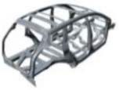
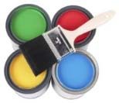



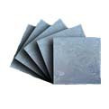



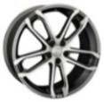

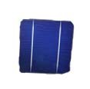
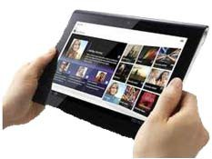

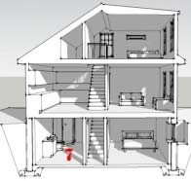
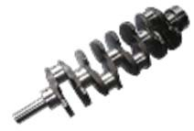
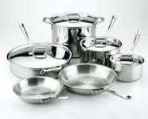


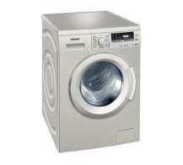

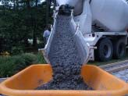

Silicon metal, silicon-based specialty alloys, and ferroalloys are critical to an array of fast‐growing end markets
Aluminum / Auto
Chemicals / Silicones
Solar
40% of silicon metal consumption
Government mandate on fuel efficiency creating new demand for light‐weight aluminum
Global growth in new automobile sales
50% of silicon metal consumption
Rise in global middle class driving strong consumer product consumption
10% of silicon metal demand
Significant growth potential
Rise in energy-related financing and residential demand for solar installations
Weather Stripping
Dashboard
Silicon
Polysilicon
Wafer
Tires
Coatings
Cables
Solar Installation
Solar Panel
Solar Cell
Electronics
Steel and Specialty Steel
Construction
Silicon market driven by demand for microprocessors needed in computers, tablets, smartphones, etc.
Manganese and silicon-based specialty alloys, and ferroalloys critical to steel industry
Long-term urbanization trends create substantial growth potential
Silicones and silica fume needed in residential and commercial construction
Improving economic conditions leading to increase in construction and infrastructure build‐out
Paint
Grout
Sealant

Slide 10
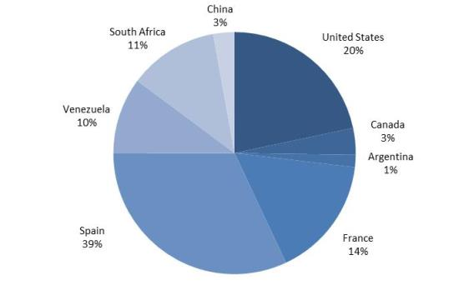
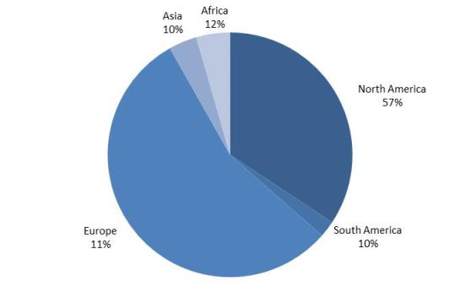
Diversified production base provides flexibility to optimize production and logistics across geographies
Manufacturing base is natural hedge against swings in power costs and F/X
Serving global customer base, with market strength in North America and Europe
Capacity by Country¹
Shipments by Region²
Notes:
1 Based on total capacities for (i) silicon metal, (ii) ferrosilicon, (iii) silicon-based alloys, and (iv) manganese based alloys
2 Reflects calendar 2015; based on total shipments for (i) silicon metal, (ii) ferrosilicon, (iii) silicon-based alloys, and (iv) manganese based alloys

Slide 11
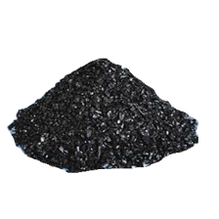
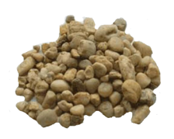
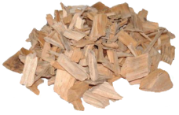
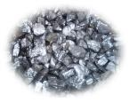
Low-cost structure built on vertically integrated supply chain, including ownership of key raw material sources
Share of self-supply of key raw materials
Ensures cost stability and logistics advantages
Need 6 tons of raw materials
Power
Specialty Coal
Quartz/Gravel
Woodchips
For one ton of Silicon Metal
+
Additional coal production capacity could supply Europe if required
Exploring additional strategic and opportunistic alternatives for quartz and manganese
FerroQuartz Mauritania

Slide 12
Ferroglobe: Market Outlook

Slide 13
Early signs of pricing improvement starting to emerge
Ferroglobe today has increased product diversification…
…which adds diversification to our revenue stream
Silicon metal: recent sale prices well-above indexes
Silicon alloy prices have been increasing modestly
Manganese alloy prices are up 8-20% since the middle of the first quarter

Slide 14
Macroeconomic indicators are generally favorable
Automotive/Auto Parts
  Third-strongest performing economic sector globally in April ‘16
  Strongest performing sector in Asia
Silicones
  Major silicone manufacturers posting stellar EBITDA growth, due to higher sales and plant utilization
Aluminum
  Alcoa expecting 2016 production growth of 6%-8% in Aerospace, 1%-4% in Automotive, and 4-6% in Construction
Metals/mining
  In April ‘16, new orders increased at fastest rate since June 2014
Eurozone
  The Big Four (France, Germany, Italy, UK) each reported economic activity jumps in April
Source: Company information

Slide 15




Global silicon consumption to grow ~6% annually
kMT
3,000
2,500
2,000
1,500
1,000
500
0
2005
2006
2007
2008
2009 2010
2011
2012 2013
China & CIS
2014E 2015E 2016E 2017E
2018E
Western World
Source: CRU

Slide 16
Silicon metal: Dynamics pointing to demand and price recovery
Silicon Consumption Growth Likely to Accelerate
Well-Positioned in Global Silicon Industry
Total Capacity (Excl. China)
1,134Ktpa
Rising Demand Expected to Drive Price Recovery in 2017-2020
Commentary
  Industry likely to benefit from market demand across a wide range of applications
  Demand expected to grow at 6% CAGR from 2016 – 2020
  CRU forecasts a 2017-2020 price recovery, driven by rising silicon demand
  Non existence of distribution or terminal market inventories contributes to relative resilience
Source: CRU 2015, Ferroglobe
Note: Silicon consumption, pricing, and capacity data are from CRU.

Slide 17
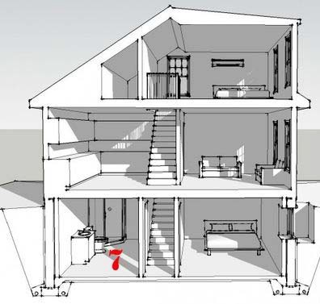
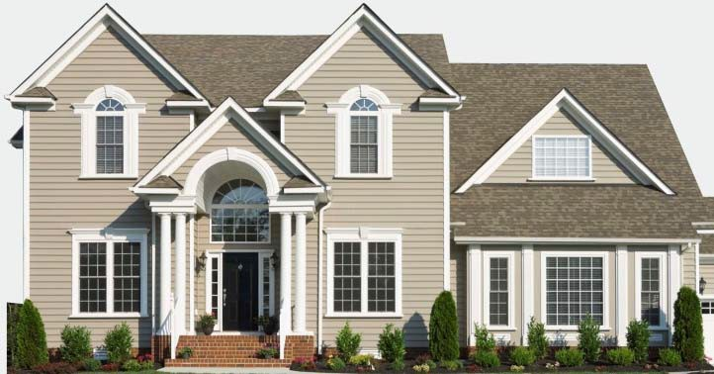

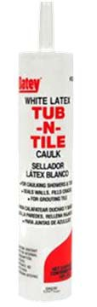


Silicones (50% of silicon metal consumption)
750,000 tons consumed by silicones industry
GDP + 4% growth – NA silicones facilities running at full capacity
Paint
Weather Stripping
Dashboard
Cables
Grout
Sealants
Tires
Coatings
Caulking Shampoo Cosmetics
Note: % of sales figures represent industry estimates of western world consumption, For additional detail on silicones end markets, visit www.silicones.eu

Slide 18
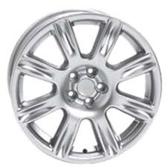
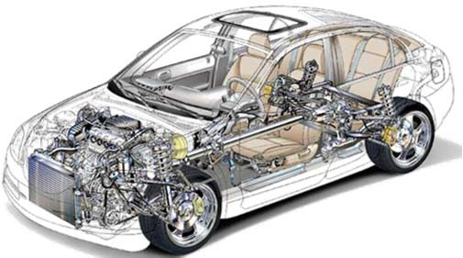






Aluminum (40% of silicon metal consumption)
Silicon metal used in aluminum as a strengthener and alloying agent to improve castability and minimize shrinking and cracking
Significant growth expected in silicon‐intensive aluminum wheels to meet EPA regulations for the trucking industry (aluminum wheels average 7.5% silicon content by weight)
Aluminum demand has increased at a 5%+ CAGR for the past 20 years
North American Light Vehicle
Global Primary Aluminum Demand Aluminum Content as a Percent of Curb Weight
(000s tons)
14.0%
13.0%
55,000
50,000
12.0%
10.4%
45,000
40,000
10.0%
8.8%
~500
Pounds
35,000
8.0%
7.1%
7.8%
30,000
6.4%
6.9%
343
Pounds
25,000
6.0%
77
Pounds
4.5%
20,000
4.0%
3.9%
15,000
2.1%
10,000
2.0%
2.0%
Approx. 10kg of silicon metal per car
5,000
0
0.0%
1970 1975
1980 1985 1990 1995 2000 2005 2010 2015E 2020E
2003 2004 2005 2006 2007 2008 2009 2010 2011 2012 2013 2014E 2015E
Source: Bloomberg and Street research
Source: Ducker Worldwide
Note: Based on 3,600 lbs of curb weight

Slide 19

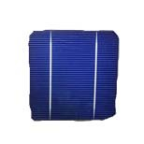

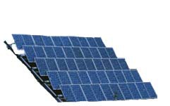
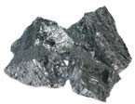
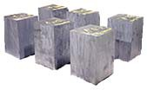


Solar (10% of silicon metal consumption)
Lower solar wafer and module prices stimulating demand
Financing companies such as YieldCos and home installations such as SolarCity driving demand acceleration
Global solar-related silicon demand in 2016 expected to be 50% higher than 2014 levels
Projections have been consistently beaten by actual growth
Global Solar Demand ― 2008 vs. 2012 Projections
Solar Installations Continue to Grow Rapidly
MW
160,000
Silicon Tons
1,200,000
MW
160,000
Silicon Tons
1,200,000
140,000
1,000,000
140,000
0
120,000 |  |  |  |  |  |  |  | 120,000 |  |  |  |  |  |  |  |  |  |  |  |  |  |  |  |  | 1,000,00
100,000 |  |  |  |  |  |  | 800,000 | 100,000 |  |  |  |  |  |  |  |  |  |  |  |  |  |  |  |  | 800,000
80,000 |  |  |  |  |  |  | 600,000 | 80,000 |  |  |  |  |  |  |  |  |  |  |  |  |  |  |  |  | 600,000
60,000 |  |  |  |  |  |  |  | 60,000
 |  |  |  |  |  |  | 400,000 |  |  |  |  |  |  |  |  |  |  |  |  |  |  |  |  |  | 400,000
40,000 |  |  |  |  |  |  | 200,000 | 40,000 |  |  |  |  |  |  |  |  |  |  |  |  |  |  |  |  | 200,000
20,000 |  |  |  |  |  |  |  | 20,000
 |  |  |  |  |  |  |  | ‐ |  |  |  |  |  |  |  |  |  |  |  |  |  |  |  |  | ‐
‐
2000
2001
2002
2003
2004
2005
2006
2007
2008
2009
2010
2011
2012
2013
2014
2015
2016
‐
2014 2015E 2016E
2017E
2018E 2019E 2020E
Implied Polysilicon Consumption
2008 Estimates (Photon) Actual Silicon (tons)
2012 Estimates Silicon (Tons)
Actual MW
2012 Estimates MW
Global Installations
Implied Silicon Consumption
Source: Credit Suisse, CRU, Photon Consulting, GTM Research, EPIA, HIS, GSM Analysis, and WSJ
Source: GTM Research, GSM Analysis
Silicon
Polysilicon
Wafer
Solar Cell
Solar
Panel
Solar
Installation

Slide 20
Manganese alloys: Expected to benefit from rising demand for steel and stainless steel
Key considerations
Global real consumption of manganese ferroalloys
  Demand for manganese alloys is driven by stainless steel production and its percentage content in steel
  Substantial potential for steel demand growth due to rising urbanization
  Automotive industry also plays a substantial role in demand
  In the past decade, silico-manganese consumption has risen at the expense of high-carbon ferromanganese and FeSi. Silico-manganese is increasingly being used as a substitute for mixtures of high-carbon ferromanganese and ferrosilicon
Silicomanganese
2010A-2019E CAGR : 3.6%
Ferromanganese
Mn Ferroalloys Production and Real Consumption
2010A-2019E CAGR : 1.8%
Under Supply
2010A-2019E CAGR 2.4%
Source: CRU Manganese Ferroalloy Market Outlook 2015 Report

Slide 21
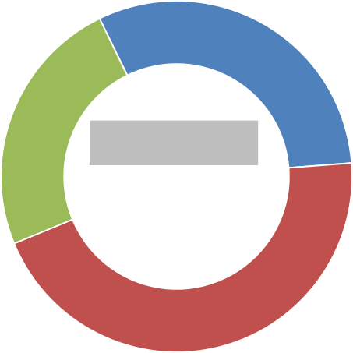
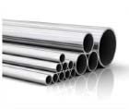

Ferroalloys essential to steel production
Total Ferroalloys Demand
Manganese Ore
Surface critical flat steel products
Some long products
Examples
Stainless steel, carbon steel, and various other steel alloys
Examples
>90%
<10%
Feedstock for Ferroalloys
Ferroalloys
Other
Consumer appliances API^{(a)} tube and pipe; rails Automotive body sheet
Standard Steel Pipes Specialty Steel Ductile iron
FeMn 24%
FeSi 31%
>90%
<10%
Ferroalloys
Total demand 2013: 25.7 mt
Steel
Other
HC FeMn
MC FeMn
SiMn 45%
SiMn
Long steel products Non‐surface critical flat products
Examples
Note: FeMn includes HC FeMn and refined FeMn; FeSi on contained Si basis
(a) American Petroleum Institute
Source: CRU, CPM, K.Fowkes, Hatch, Macquarie Research
Construction steels Unexposed car parts

Slide 22
FerroQuartz Mauritania

Slide 23
Overview
Company name: Ferroquartz Mauritania S.A.R.L.
Project started: 2012
Two Mining Permits: Vadel 1: 195 Km2 and Vadel 2: 240 km2
Silicon metal quality reserves: 2,21 Mt (Vadel 1: 1.08 Mt and Vadel 2: 1.13 Mt)
Total Investment necessary to develop the whole Project: 3,25 M€
Minimum production: 85.000 t/y (Life of mine: 20 years)
Production process:
  Screening and sorting in mine.
  Transport by truck: Vadel 1 to port: 250 km / Vadel 2 to Port:200 km
  Washing, screening and sorting in Nouadhibou plant- Free Area Nouadhibou
  Transport by truck from Free area Nouadhibou to Nouadhibou port (5 km)

Slide 24
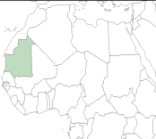
Location
FerroQuartz
Mauritania

Slide 25
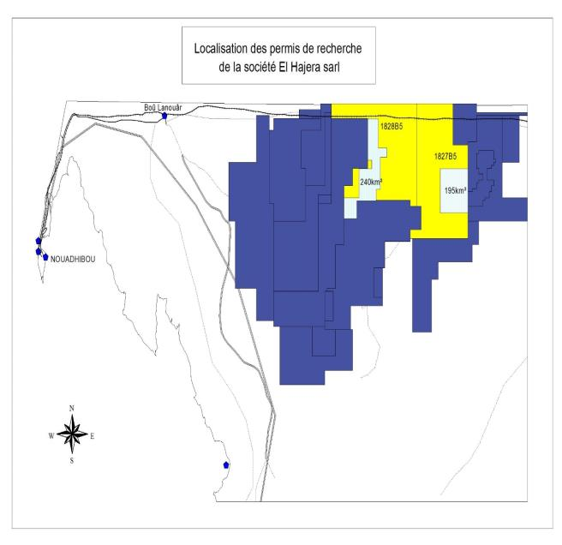
Location
Vadel 1
Vadel 2
Distance to port:
Vadel 1= 250 km
Vadel 2= 200 km

Slide 26
Exploration
Exploration in several steps: started in 2012 and finished in 2015.
Exploration figures:
  Cartography: Detailed geological mapping. 380 surface samples and analysis. Identification of potential areas.
  Exploration campaign in Vadel 1 and Vadel 2:
    Trenches > 4.000 m
    Shafts excavations > 30
    Tons moved > 40.000 t
    Lab analysis: around 150 samples
    Checked the mineralization areas in Vadel 1 and 2
  Industrial trial:
    2.000 t Industrial trial in the Sabón factory successfully performed
    The quartz quality is prefect to produce silicon metal

Slide 27
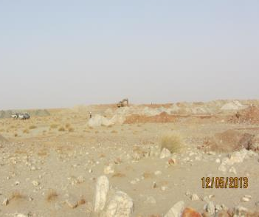
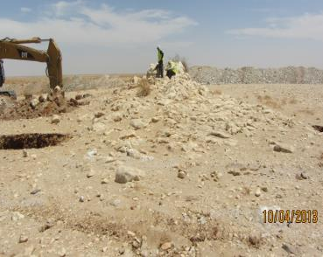
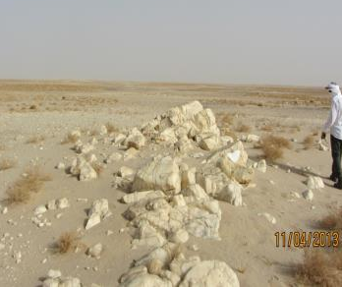
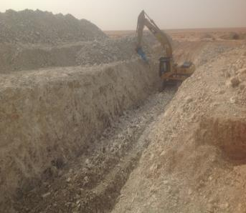
Exploration
Intensive survey of target area
Mineable surface outcrops
Mineable surface outcrops
Testing smoked quartz mining

Slide 28
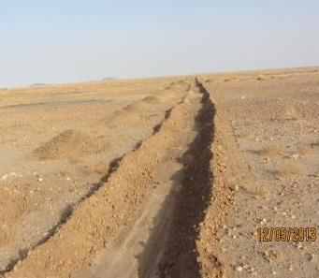
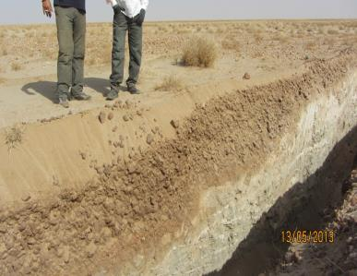
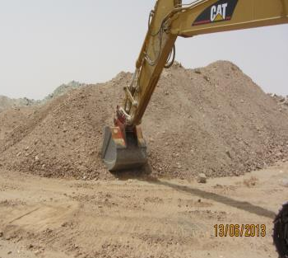
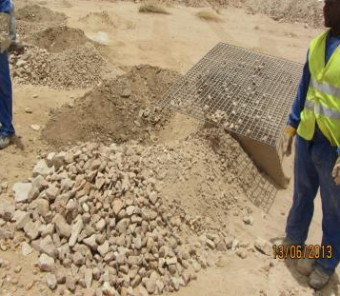
Exploration
Floating quartz areas demarcation
Floating quartz thickness measurement
Floating quartz experimental production
Floating quartz yield test

Slide 29
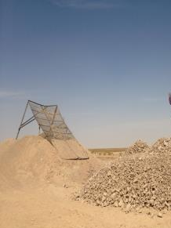
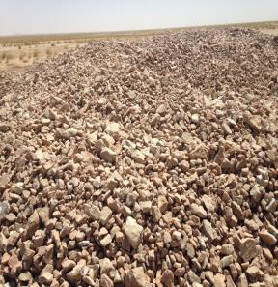
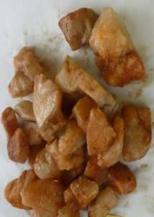
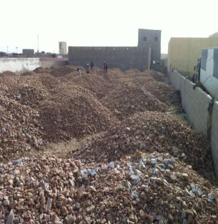
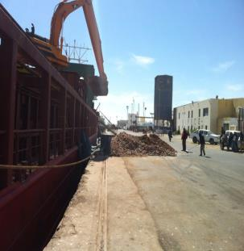
Industrial Trial
Mina Vadel. 2.000 t industrial production
Nouadhibou-Stock area
Nouadhibou-Loading the trial shipment

Slide 30
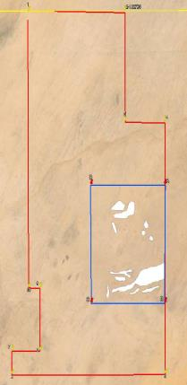
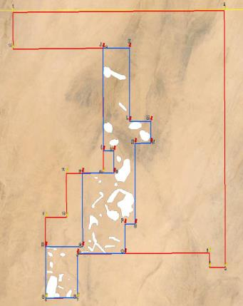
Reserves: Measured + Indicated + Inferred
VADEL 1
VADEL 2

Slide 31
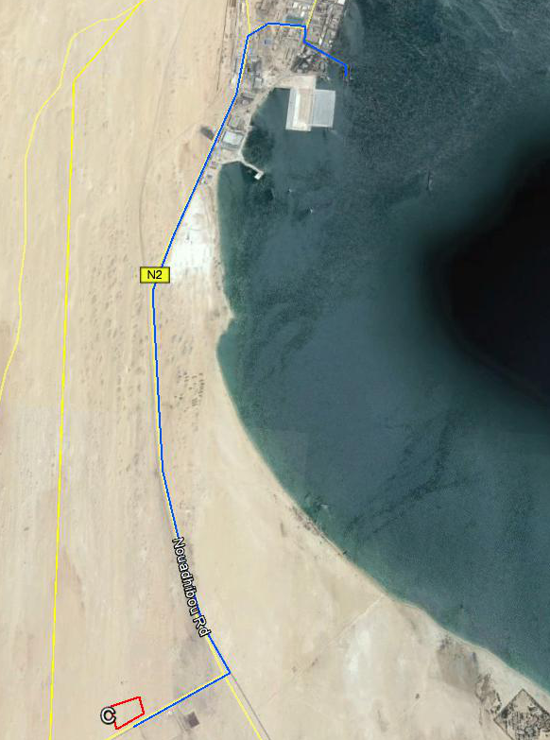
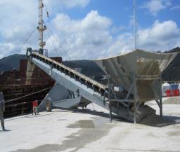
Flowsheet
Mine production (min 90,000 tpy)
Transport from mine to washing plant (Nouadhibou free área) (250/200 km) (250 t/d)
Process in washing plant and sorting (250 t/d) (Free área Nouadhibou)
Loading a ship (max. 8,000 t per ship) (10-11 min. ships per year): 85.000 tpy
Transport from washing plant to port (5 km)
Quality control

Slide 32
Nouadhibou Plant
Area: 18,123 m2

Slide 33
Project Planning
  2016/2017. Next steps:
        Construction of the free area facilities - Washing plant
        Construction of the mining facilities - Campsite
        Mining production startup
        Initial delivery to our factories

Slide 34
Advancing Materials Innovation
NASDAQ: GSM

